Slide 1
June 3
Week 1, Day 2

Slide 2
Data Science vs Data Analytics

Slide 3
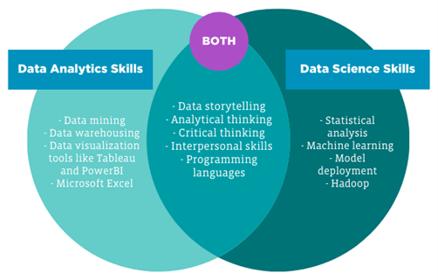
Data Science vs Data Analytics
Notes:
Data analysis is used to uncover insights in the data
Data science is used to utilize data in model development

Slide 4
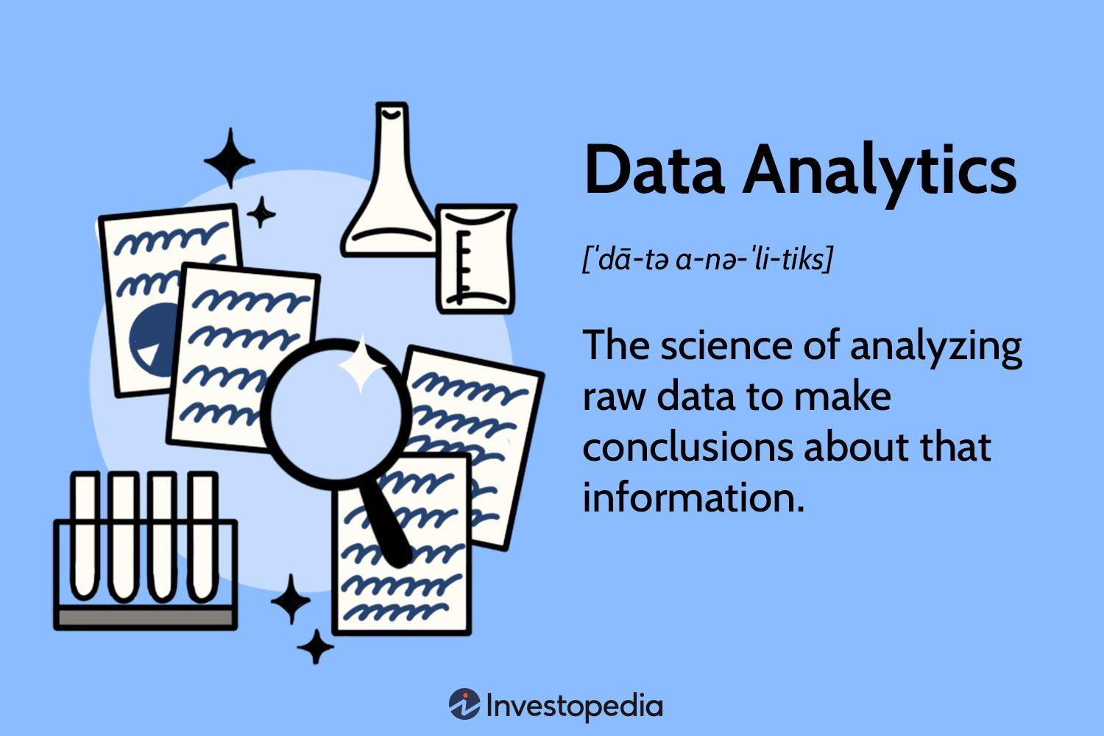
Data Analytics
What is data analytics useful for?
Helps individual and organizations discover trends and insights
Helps with informative decision making
What are the types of data analytics?
There are three types of data analytics, descriptive, diagnostic, predictive and prescriptive.

Slide 5
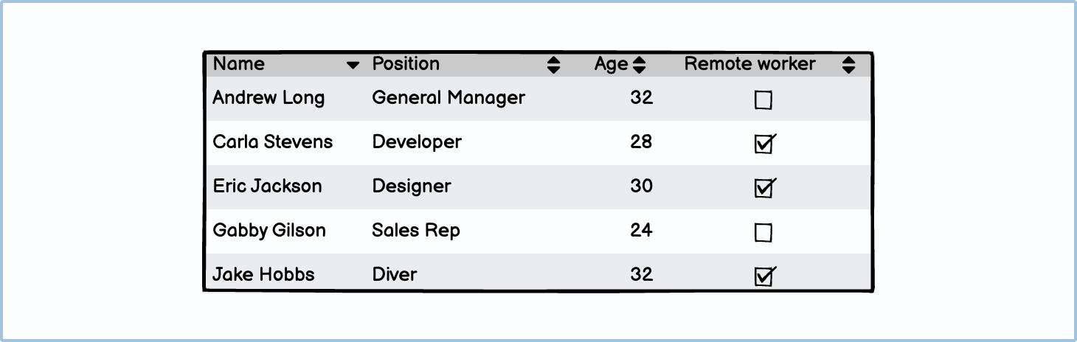
Data vs Information
What is the difference between data and information?

Slide 6
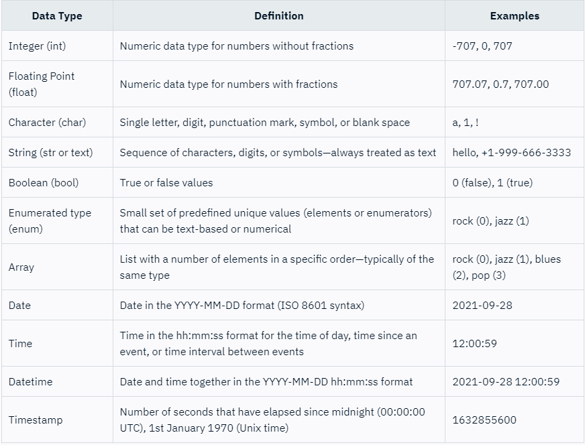
Data Types

Slide 7
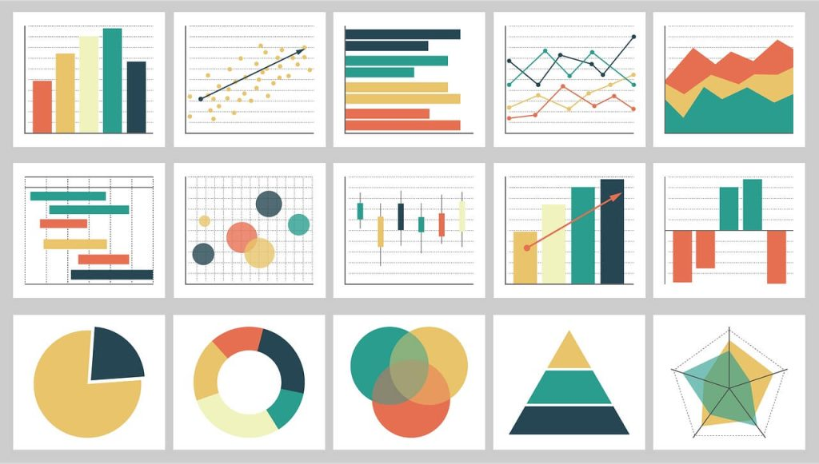
Descriptive analytics
Answers the question, “What happened?”
Data mining
Demand trends
Aggregated results

Slide 8
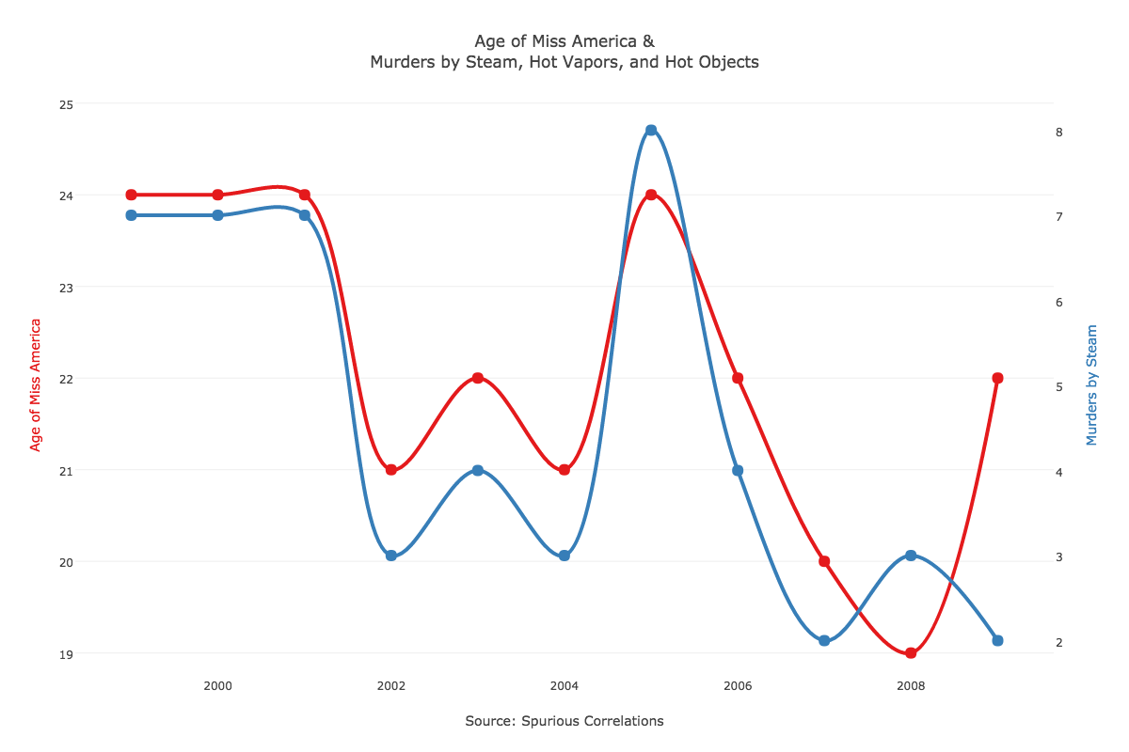
Diagnostic analytics
Answers the question, “Why did this happen?”
Hypothesis testing
Correlations
CORRELATION IS NOT CAUSATION!!!!
Notes:
Learn more: https://online.hbs.edu/blog/post/diagnostic-analytics

Slide 9
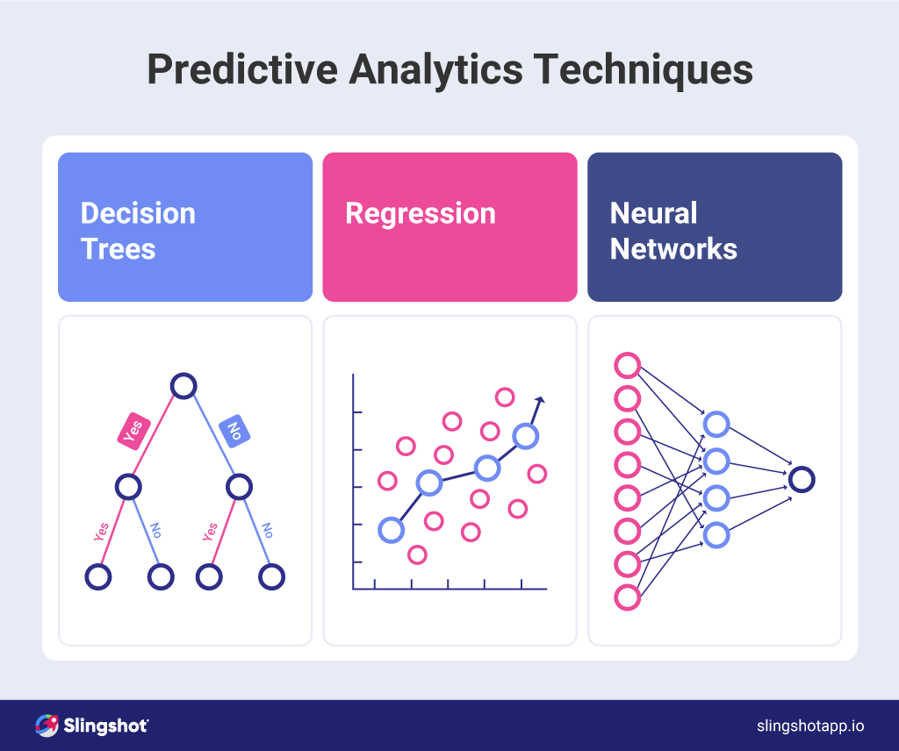
Predictive analytics
Answers the question, “What might happen in the future?”
Forecasts
Detection
Notes:
Learn more: https://online.hbs.edu/blog/post/predictive-analytics

Slide 10

Prescriptive analytics
Answers the question, “What should we do next?”
“is the process of using data to determine an optimal course of action.”
Recommendations
Optimization
Notes:
Learn more: https://online.hbs.edu/blog/post/prescriptive-analytics

Slide 11
Break

Slide 12
How to conduct a data analytics project
Frame the problem and look at the big picture
Get the data
Explore the data for any inconsistencies
Prepare the data
Explore the data for insights
Present your insights

Slide 13
PetMe
PetMe is a nonprofit organization that helps finding homes for exotic rescue pets (think crocodiles, lamas, and monkeys). PetMe board is certain that there are people interested in rescuing these animals but they don’t know what to do about it. The board reached out to a data analytics consultancy to help them with this task.

Slide 14
Problem framing
Define the objective in business terms
How will the solution be used?
How should the performance be measured?
Is the performance measure aligned with the business objectives?
List the assumptions you made in designing the solution

Slide 15
Get the data
List the data you need and how much you need.
Make sure that your data is representative
Check access authorization
Get the data
Convert the data format to one you can manipulate
Ensure sensitive information is deleted or protected

Slide 16
Explore the data for any inconsistencies
Create a copy of the data (don’t mess with the original files)
Study each attribute and its characteristics:
Data type
% of missing values
Outliers
Type of distribution
Visualize the data
Study the correlation between attributes
Identify transformations you can apply
Identify extra data that would be useful
DOCUMENT EVERYTHING!!!

Slide 17
Prepare the data
Write functions for all data transformations for repeatability
Fix or remove outliers
Fill in missing values
Drop values that provide no useful information

Slide 18
Explore the data for insights
List the questions you want to answer
Check the different ways your data can answer these questions
Find the most suitable method to represent your insight
Document the decisions you made in exploring your insights

Slide 19
Present your insights
Document what you have done
Create a presentation to demonstrate your insights
Explain why your solution archives the business objective
Present the interesting points you discovered
Describe what worked and what didn’t
List your assumptions and limitations

